Slide 1
OCaml: Folding
CMSC 330: Programming Languages

Slide 2
OCaml Review
Types, Values, and Expressions
Bindings
Strong Typing + Type Inference
Functions + Tail Recursion
Pattern Matching
Lists, Tuples, and Strings
Variants + Recursive Types
Folding ←We are at the end!!

Slide 3
List Operations
Examples: List.map, List.rev
Three Major Classes:
Transforming Elements: map
Removing Elements: filter
Combining Elements: fold

Slide 4
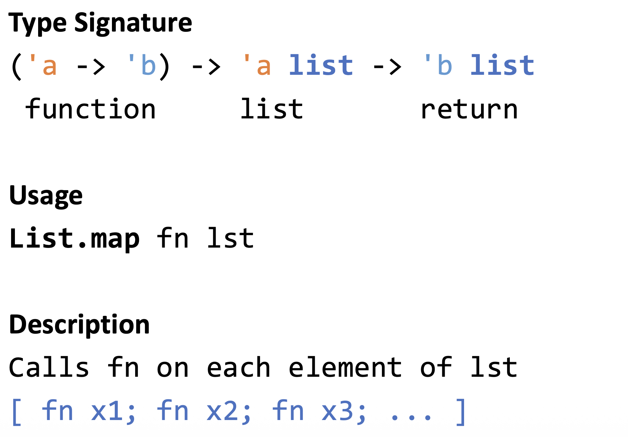
List Operation: map

Slide 5
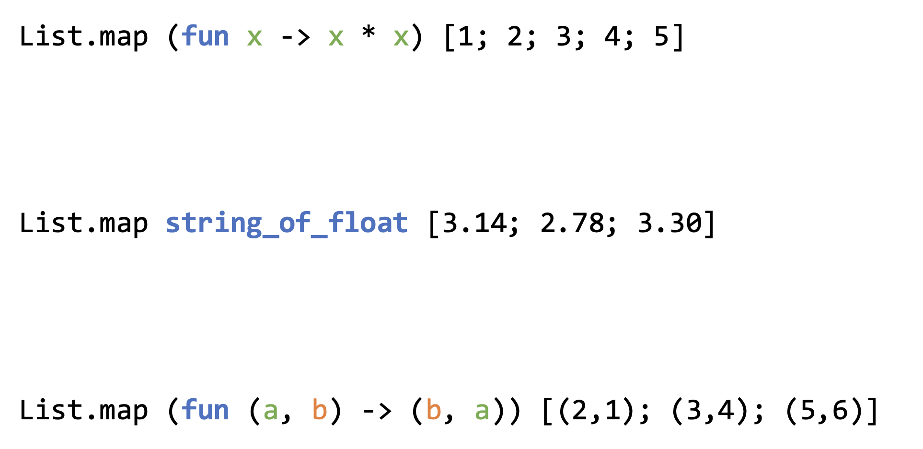
map Examples
Notes:
tuple_expr:
| LPAREN expr COMMA expr_list RPAREN { tuple with 2+ elements }
expr_list:
| expr { last element }
| expr COMMA expr_list { element followed by rest }

Slide 6
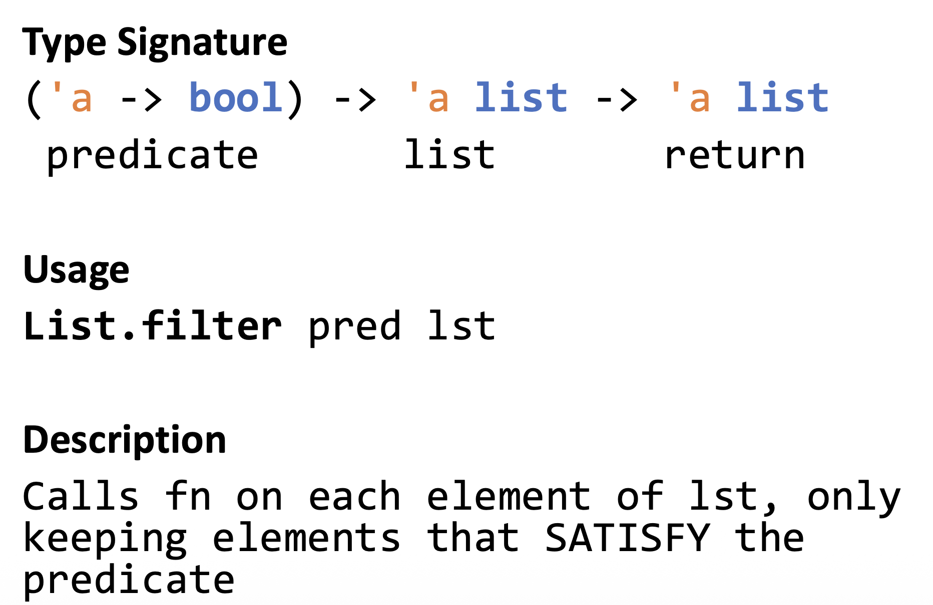
List Operation: filter
Notes:
You can match both by using let (x, y) = pt

Slide 7
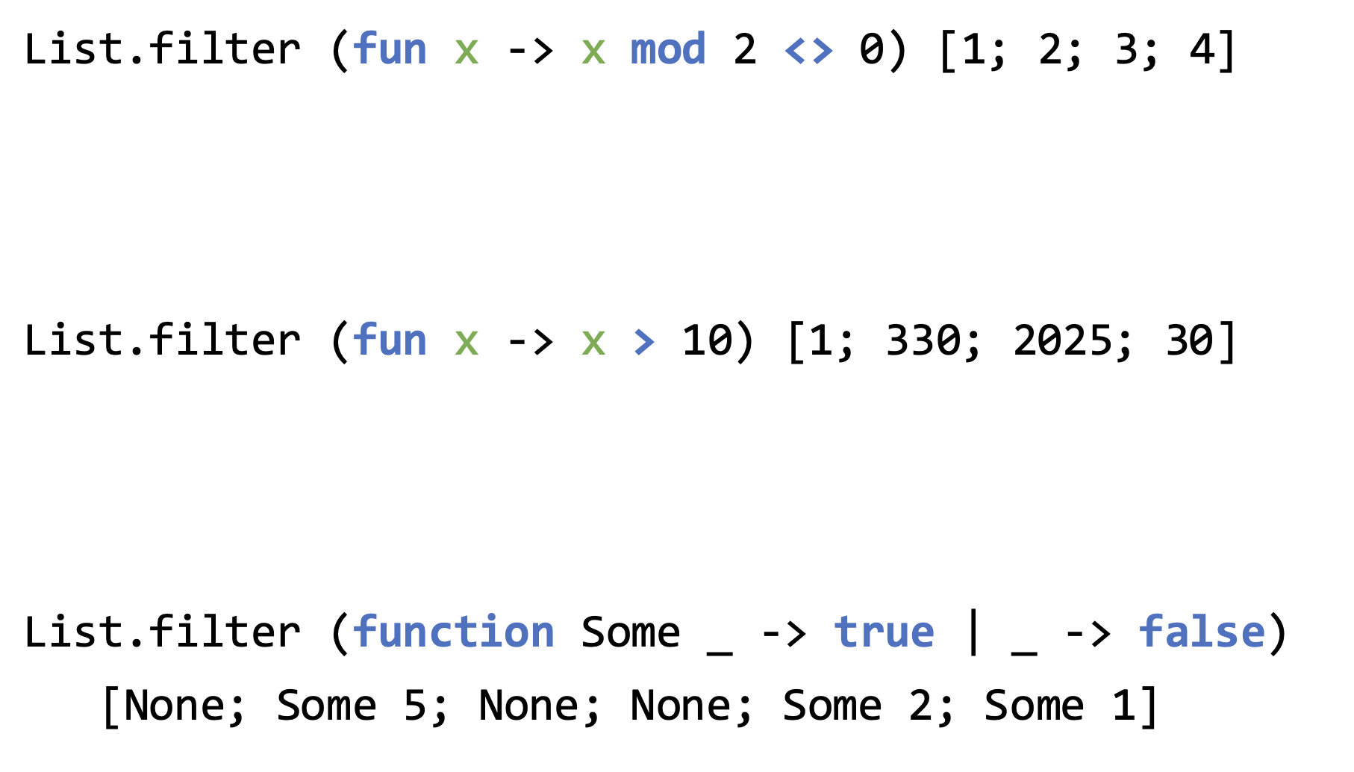
filter Example
Notes:
Let eq = let (first, _, _, _, last) = big in
first = last

Slide 8
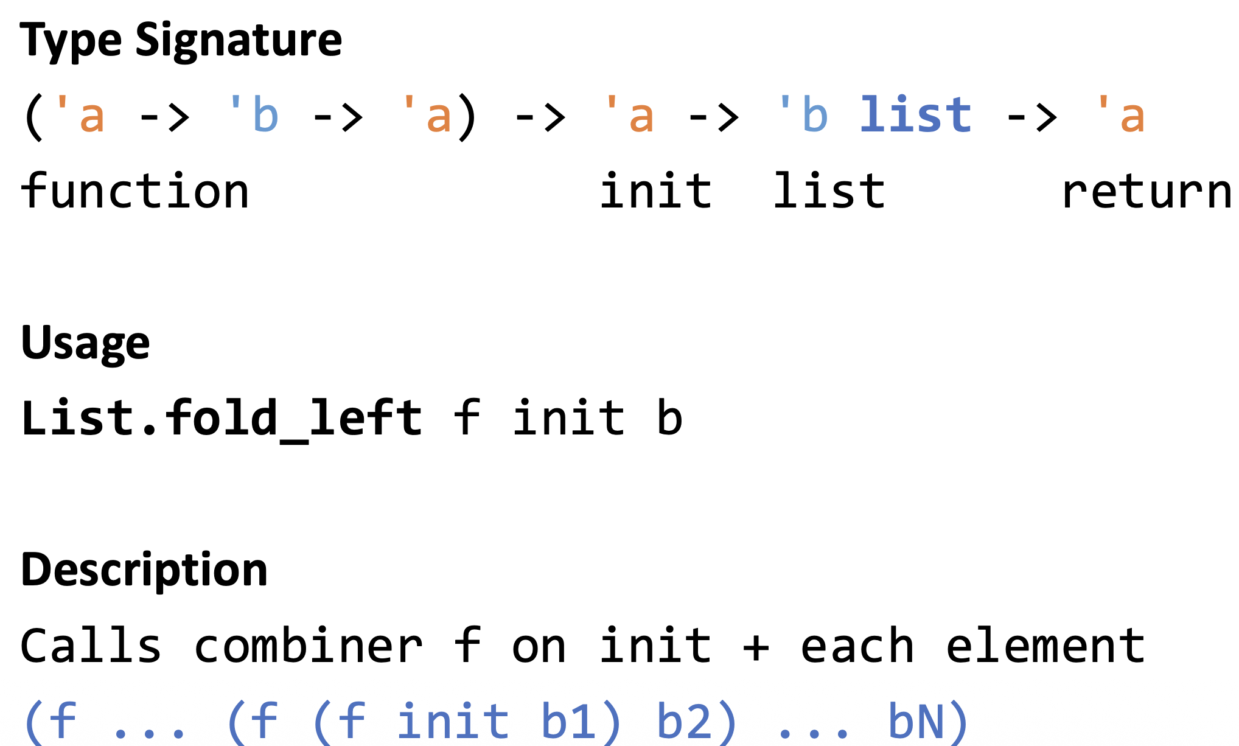
List Operation: fold_left

Slide 9
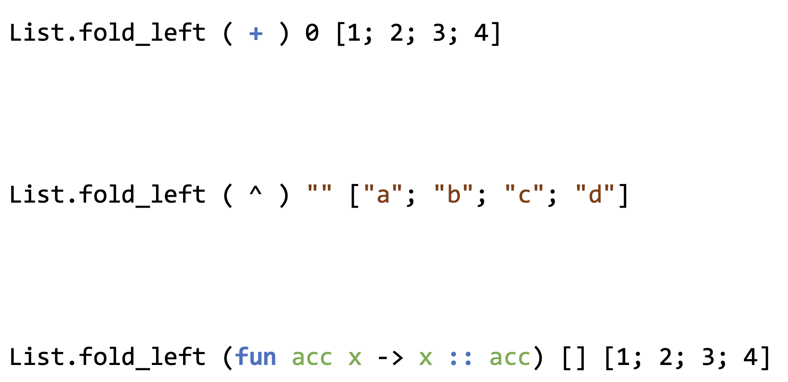
fold_left Examples

Slide 10
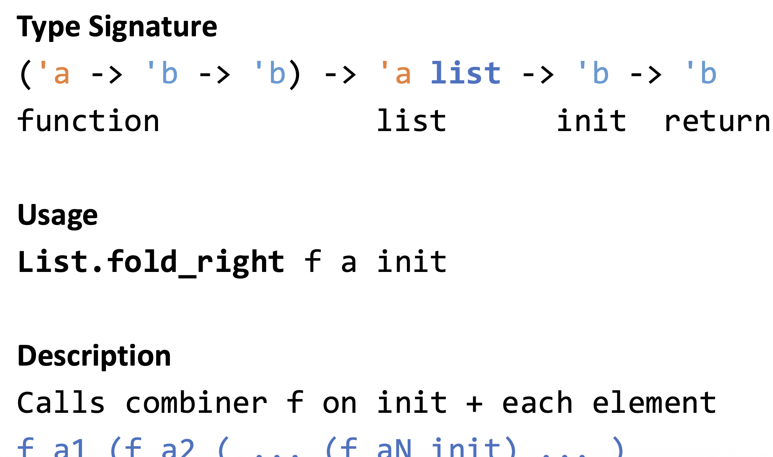
List Operation: fold_right

Slide 11
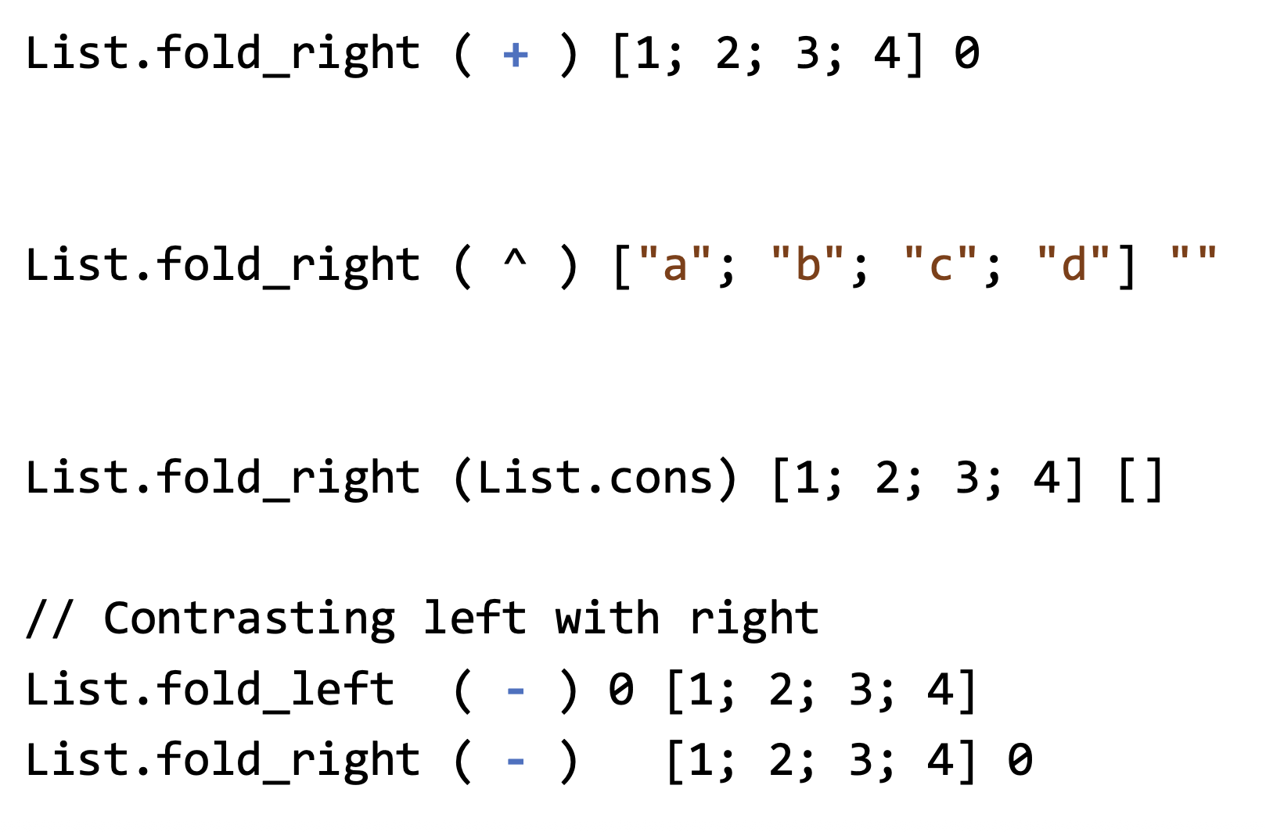
right_fold Examples
Notes:
Left fold associates to the left:
(((0 - 1) - 2) - 3) - 4 = (-1 - 2) - 3 - 4 = (-3 - 3) - 4 = -6 - 4 = -10 Right fold associates to the right:
1 - (2 - (3 - (4 - 0))) = 1 - (2 - (3 - 4)) = 1 - (2 - (-1)) = 1 - 3 = -2

Slide 12
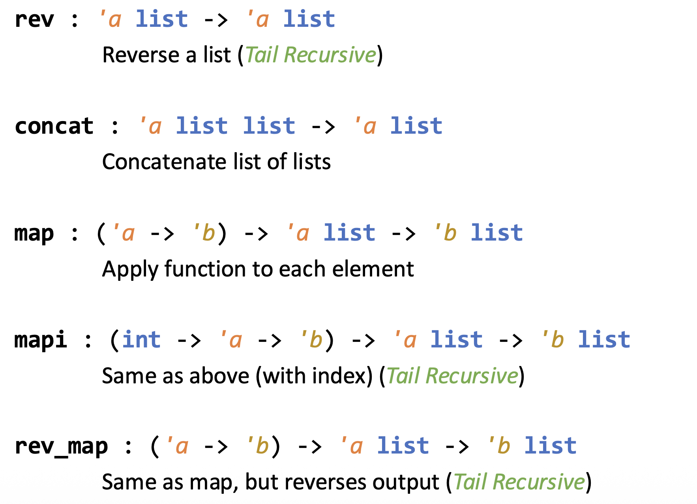
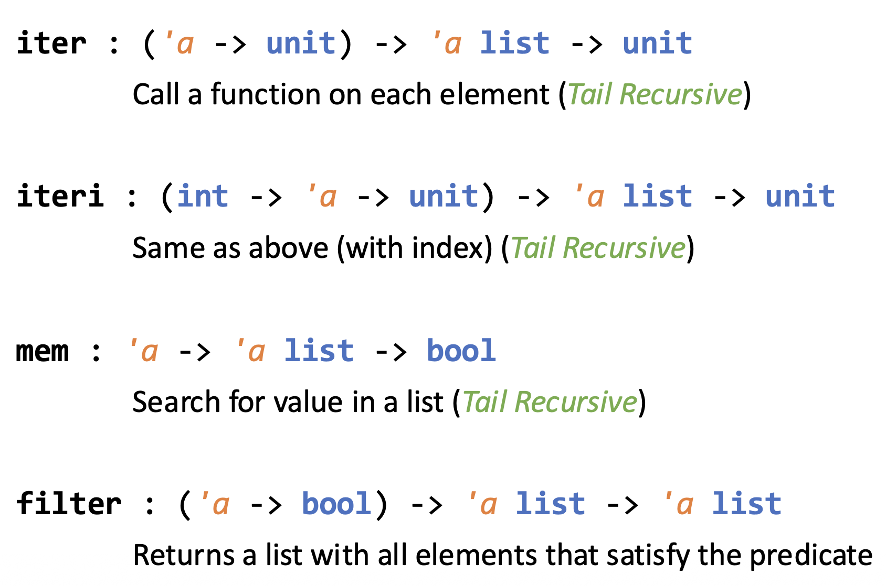
List Module

Slide 13
Everything is a Fold
Sum:
Map:
Filter:
Length:

Slide 14
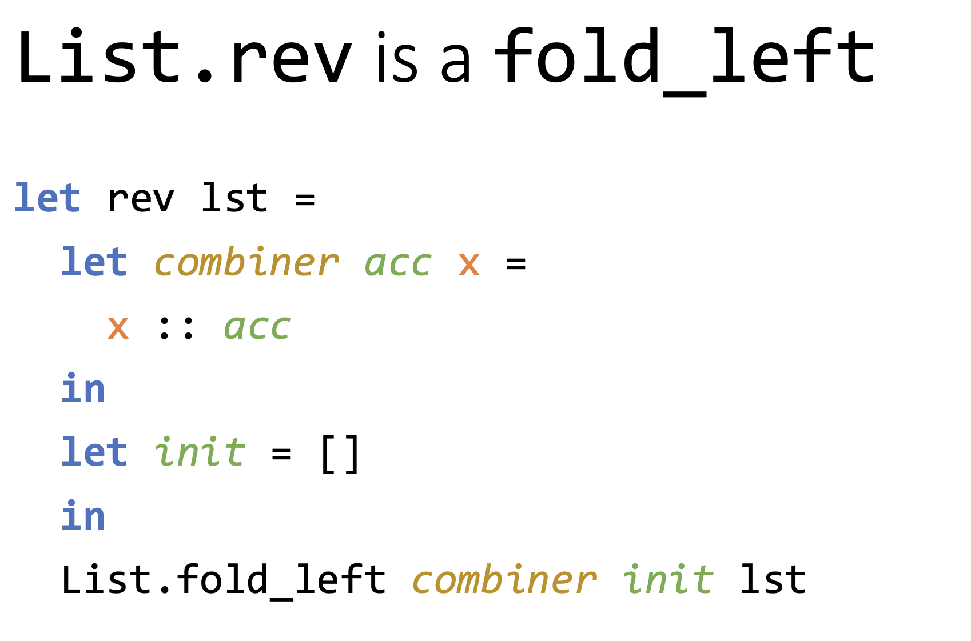

Slide 15
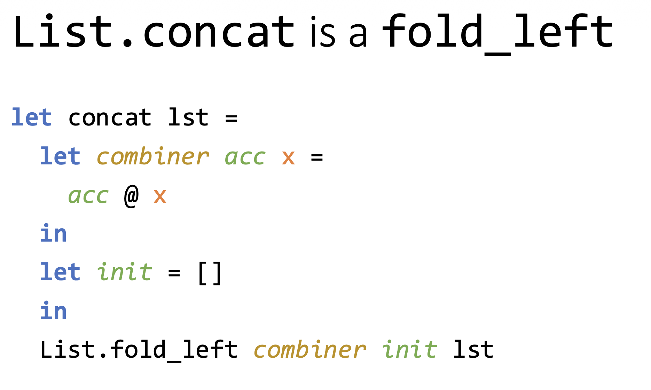
Notes:
In OCaml, List.concat flattens a list of lists into a single list.
Definition (clean)
List.concat : 'a list list -> 'a list
Example
List.concat [[1;2]; [3;4]; [5]] (* result: [1;2;3;4;5] *)
A non-tail-recursive version: List.fold_right (@) lst []

Slide 16
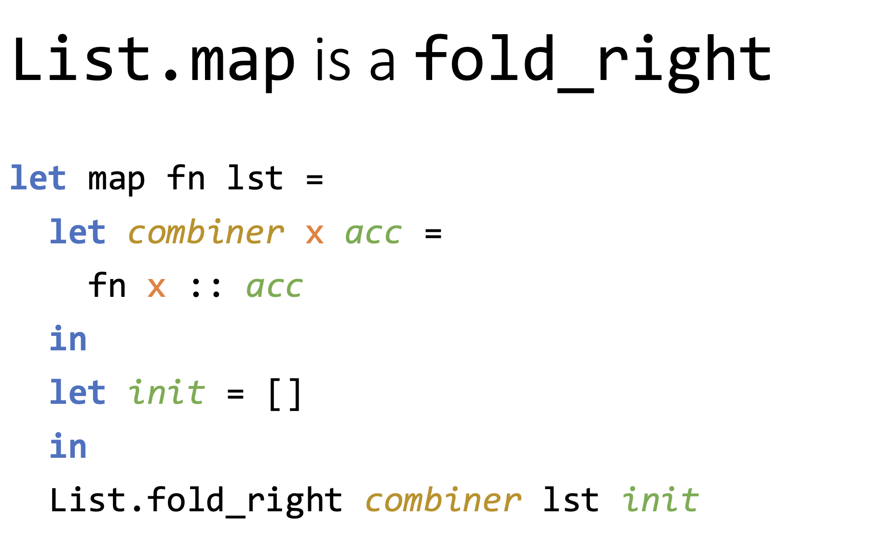

Slide 17
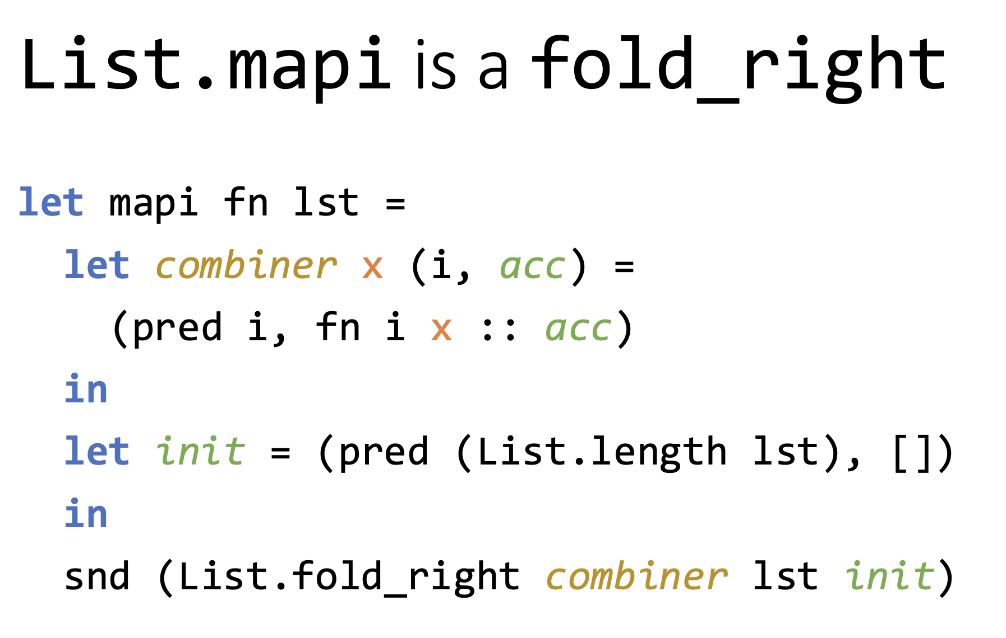
Notes:
List.mapi maps with access to element indices.
pred 10 (* 9 *)
Example
List.mapi (fun i x -> (i, x)) ["a"; "b"; "c"] (* result: [(0,"a"); (1,"b"); (2,"c")] *)
Another example
List.mapi (fun i x -> i + x) [10; 20; 30] (* result: [10; 21; 32] *)

Slide 18
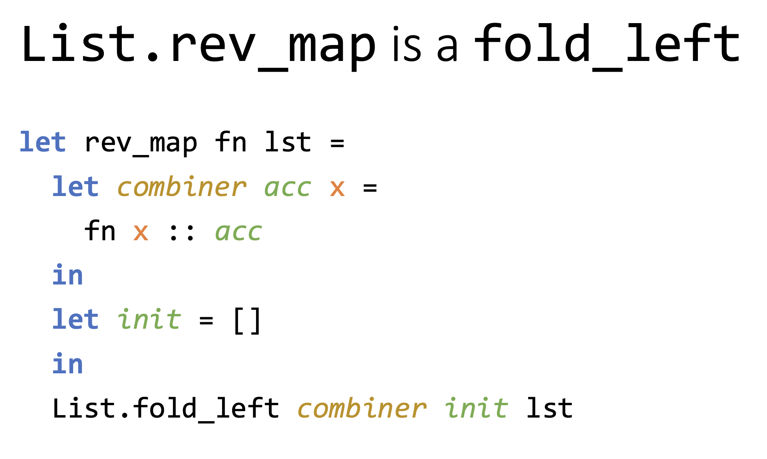

Slide 19
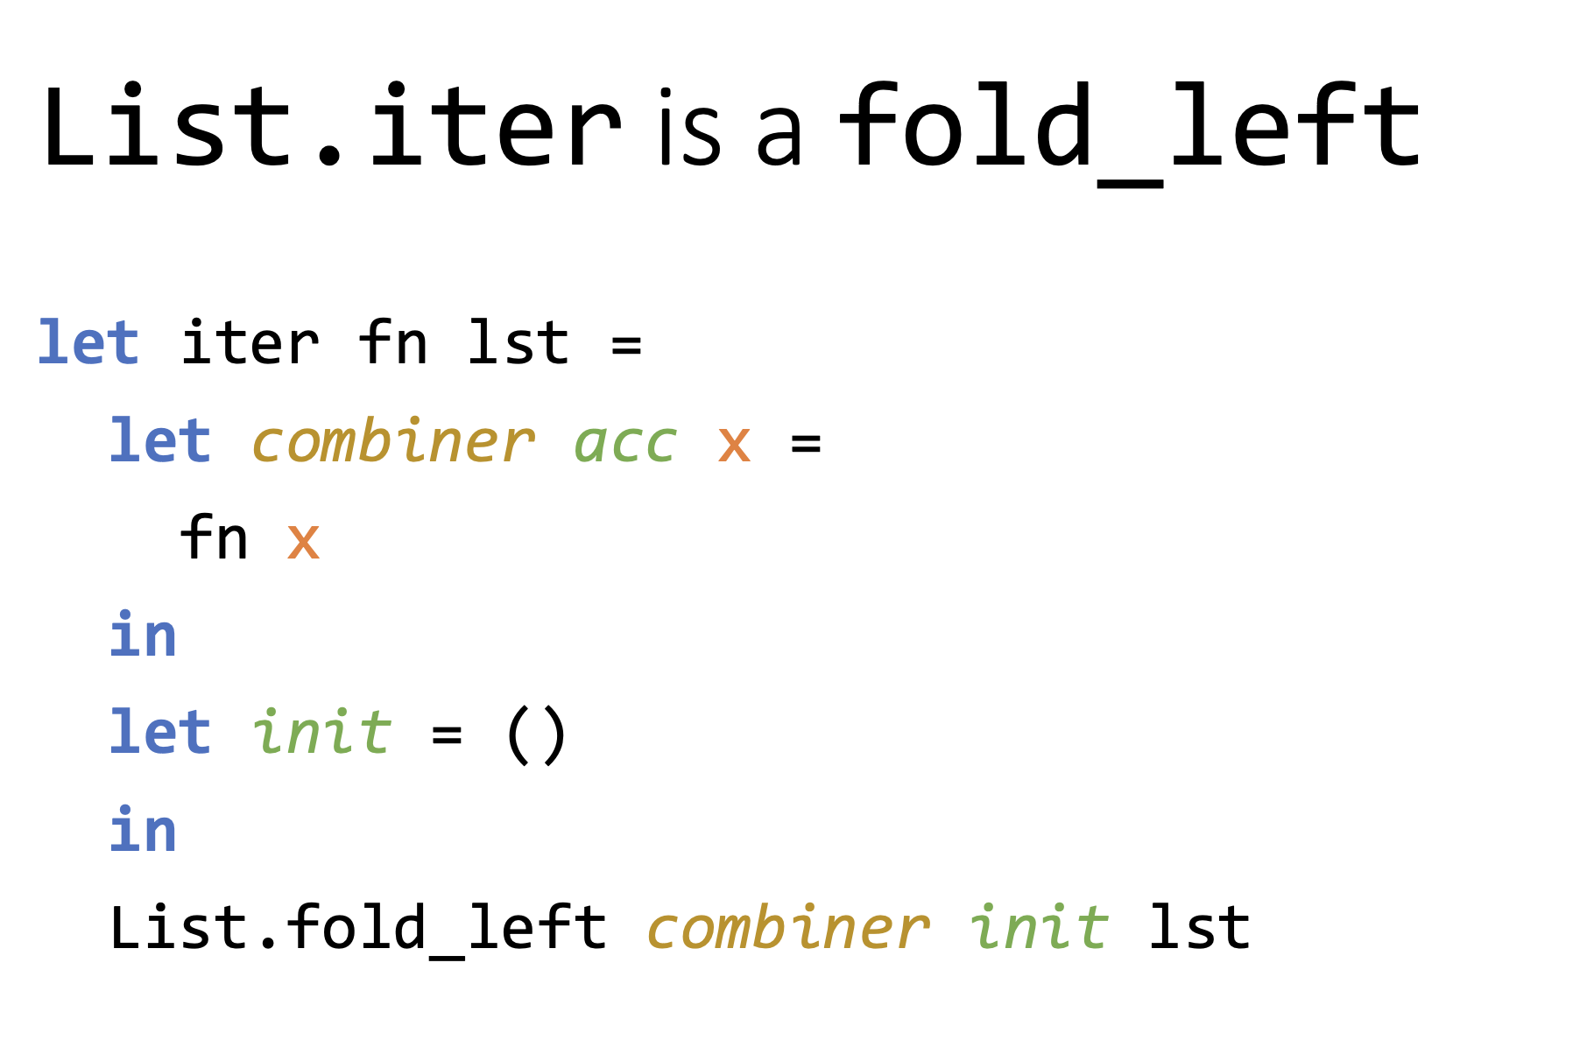

Slide 20
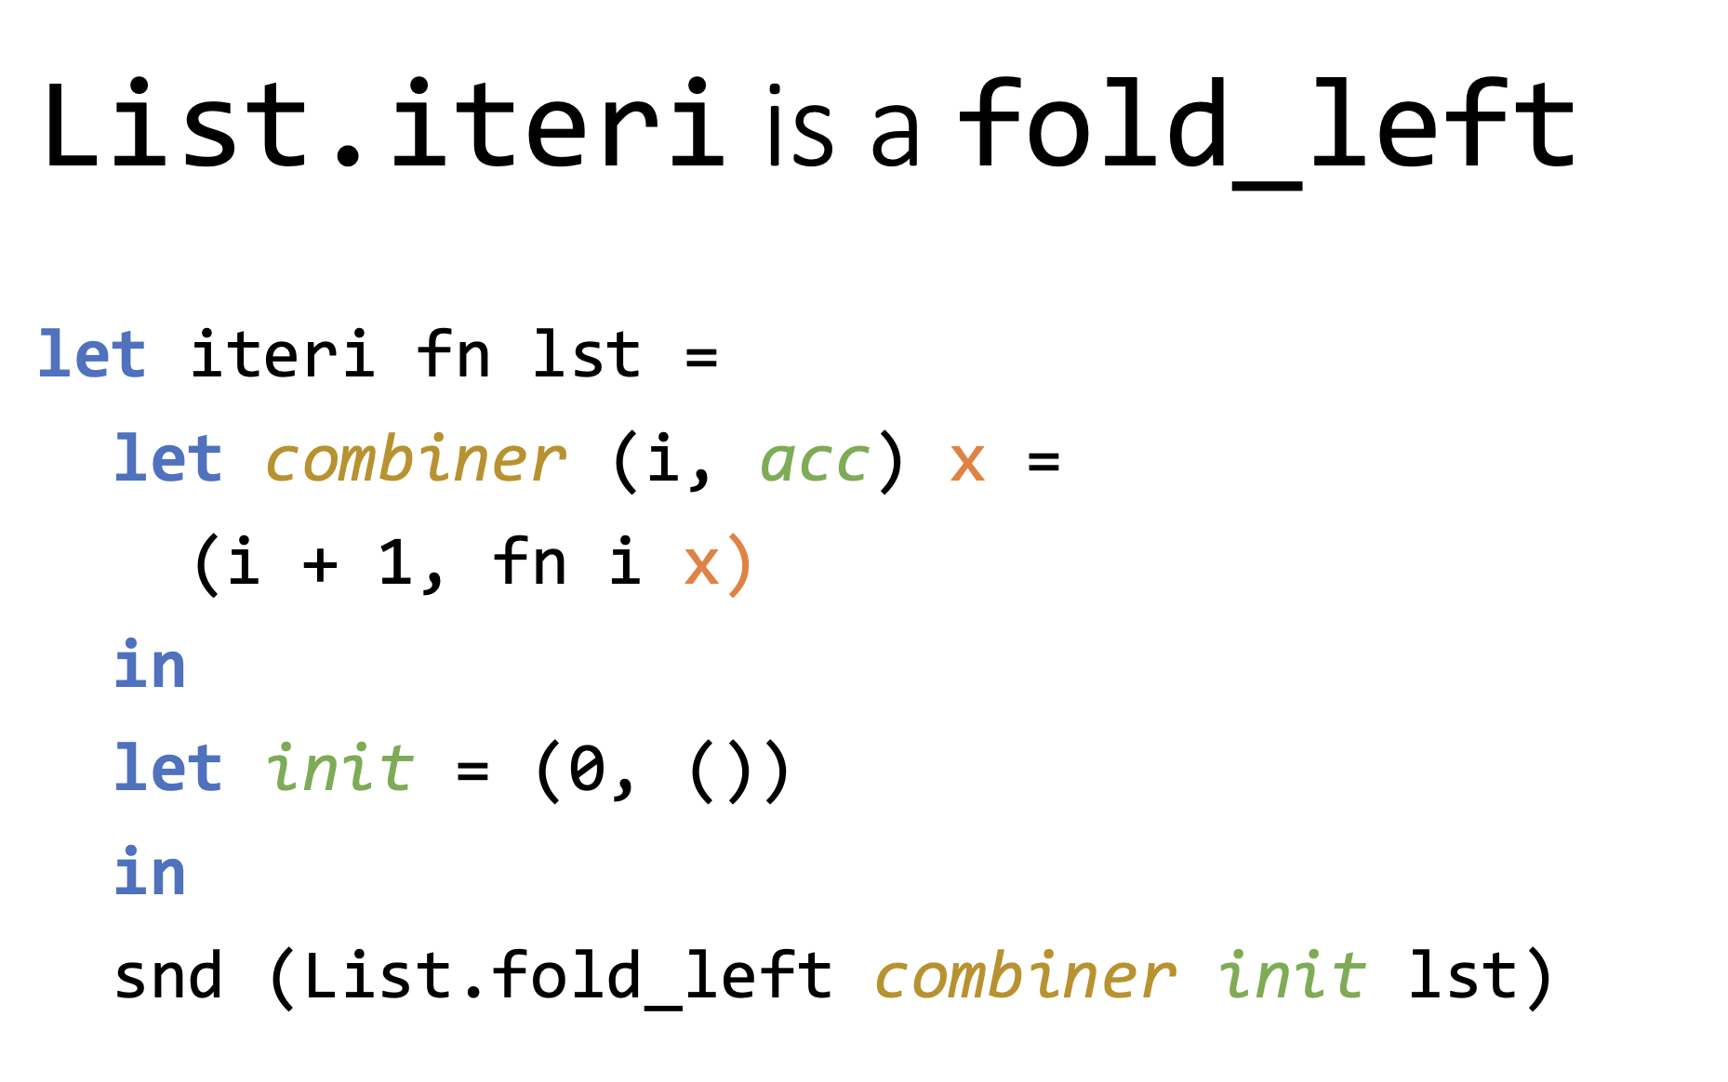

Slide 21
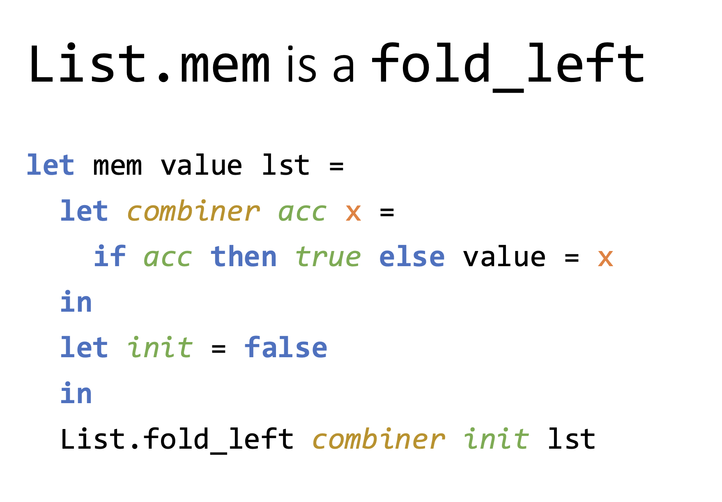

Slide 22
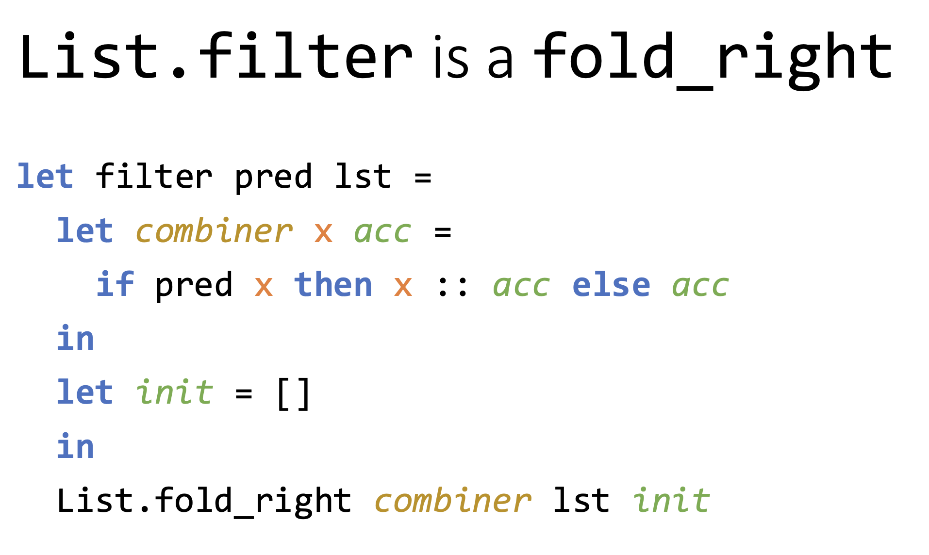

Slide 23
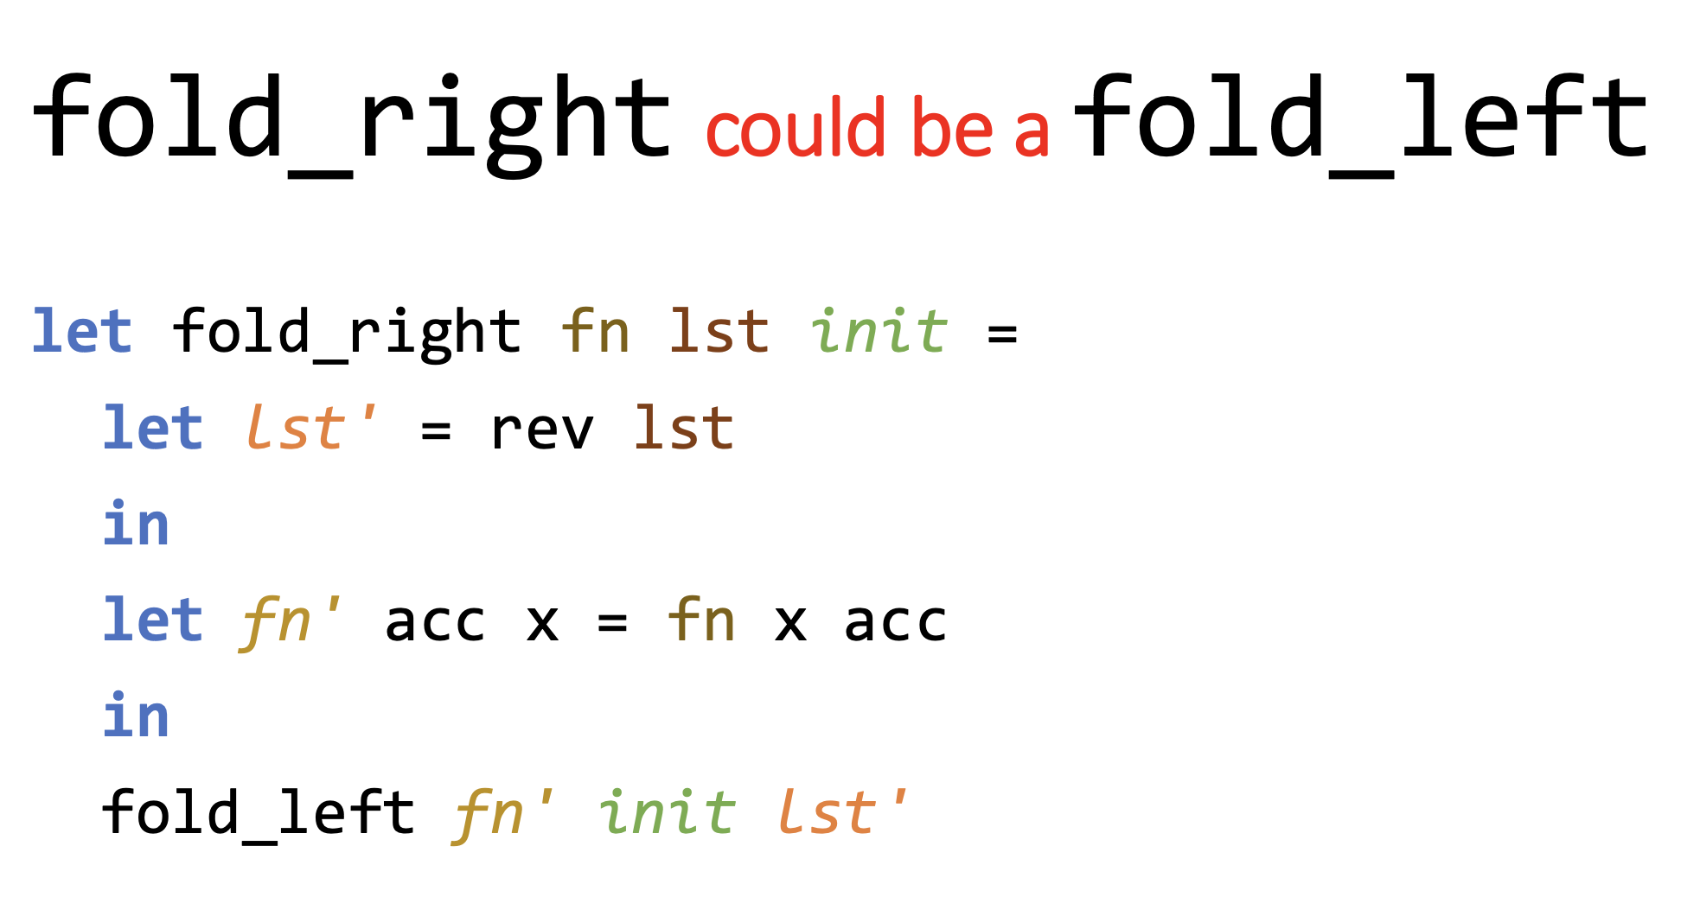

Slide 24
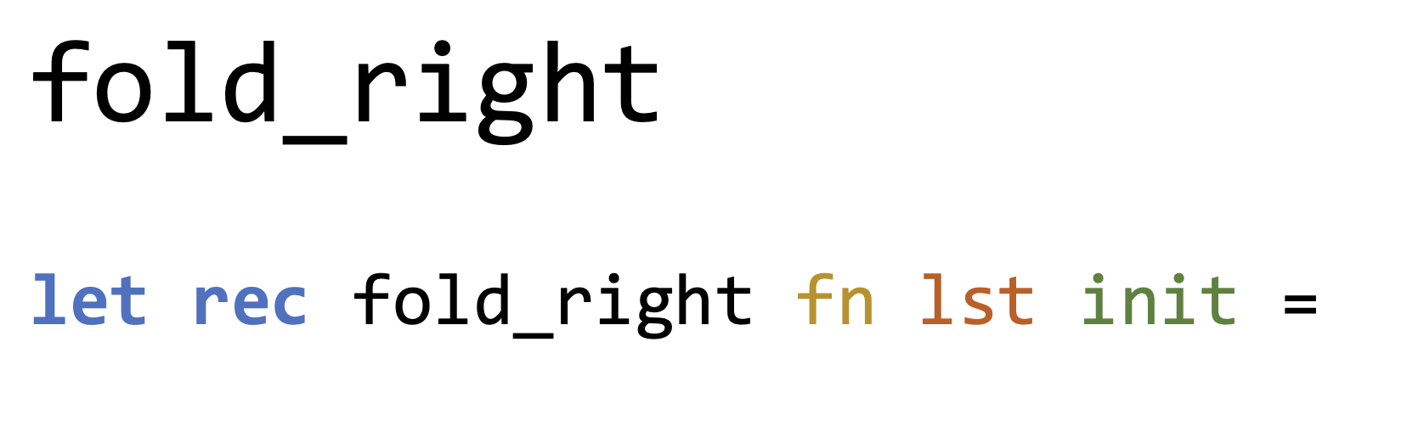
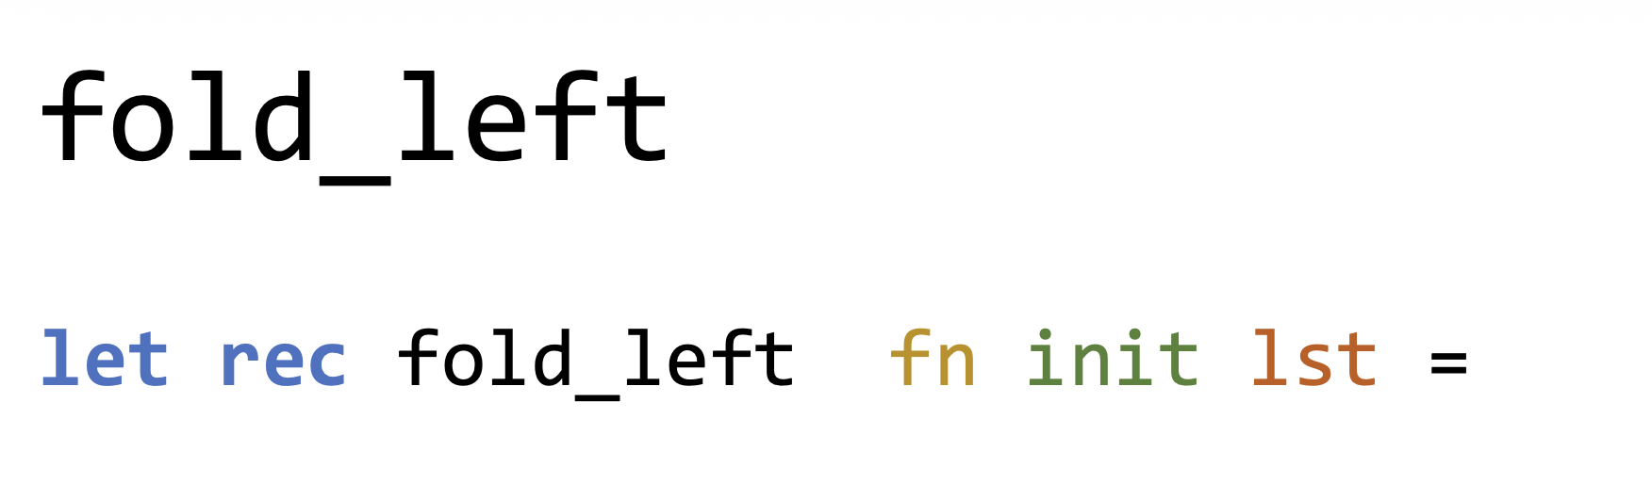
Implement fold_left And fold_right
Notes:
let rec fold_left fn init lst =
match lst with
[] -> init
| x::lst'
->
fold_left fn (fn init x) lst’
let rec fold_right fn lst init =
match lst with
[] -> init
| x::lst'
->
fn x (fold_right fn lst' init)

Slide 25
OCaml Completed
You now learned a functional programming language
One more lab to go
Enjoy the hd::tl’s

